Slide 1

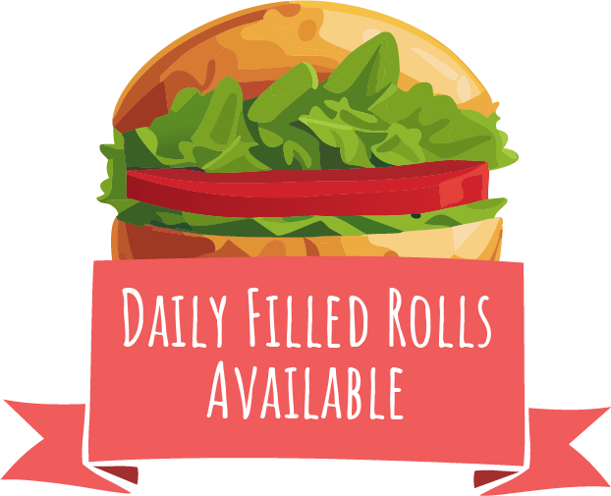

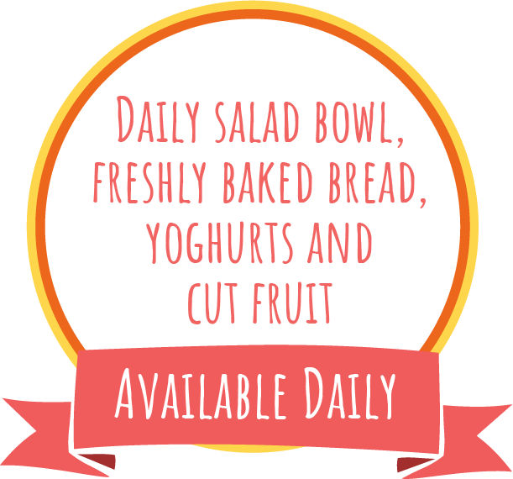



Week 1
Spring Summer 2025
21/04/25, 12/05/25, 02/06/25, 23/06/25, 14/07/25, 04/08/25, 25/08/25, 15/09/25, 06/10/25
All Day Breakfast
Margherita Pizza Slice and Wedges
Baked Beans
Beans,
Cheese or
Tuna Mayo
Yoghurt & Fruit
Picnic Style
Sausage Roll Lunch
Picnic Style
Veggie Sausage Roll Lunch
Crudites
Beans,
Cheese or
Tuna Mayo
Yoghurt & Fruit
Roast Chicken, New Potatoes, Stuffing and Gravy
Vegetable and Stuffing Loaf with New Potatoes
Beans,
Cheese or
Tuna Mayo
Carrots and Cabbage
Pudding of the Day
Tomato and Basil Chicken
Pasta Bake
Veggie Noodle
Stir Fry
Green Salad
Beans,
Cheese or
Tuna Mayo
Yoghurt & Fruit
Hot Pasta topped with Homemade
Tomato Sauce & Cheese
Golden Fish Fingers
and Chips
Cheesy Bean Wrap with Chips
Beans,
Cheese or
Tuna Mayo
Fruit & Yoghurt
Peas
W1

Slide 2
Week 2
Spring Summer 2025
28/04/25, 19/05/25, 09/06/25, 30/06/25, 21/07/25, 11/08/25, 01/09/25, 22/09/25, 13/10/25
Beef Bolognese
Pasta
Veggie
Bolognese
Pasta
Beans,
Cheese or
Tuna Mayo
Fruit & Yoghurt
Sweetcorn
and Peas
BBQ Chicken Wraps and Paprika Wedges
BBQ Veggie Wrap and Paprika Wedges
Green Beans
Beans,
Cheese or
Tuna Mayo
Fruit & Yoghurt
Roast chicken,
Skin on Roasties, Stuffing and Gravy
Maple Roasted Sweet Potato Filo Pie with Skin on Roasties
Beans,
Cheese or
Tuna Mayo
Mixed Greens
Pudding of the Day
Sausage, Mash
and Gravy
Veggie Sausage
and Mash
Carrots and
Green Beans
Beans,
Cheese or
Tuna Mayo
Fruit & Yoghurt
Hot Pasta topped with Homemade
Tomato Sauce & Cheese
Golden Fish Fingers
and Chips
Cheese and Onion Burger
with Chips
Beans,
Cheese or
Tuna Mayo
Fruit & Yoghurt
Baked
Beans
W1

Slide 3
Week 3
Spring Summer 2025
05/05/25, 26/05/25, 16/06/25, 07/07/25, 28/07/25, 18/08/25, 08/09/25, 29/09/25, 20/10/25
BBQ Sweetcorn Pizza Slice
with Wedges
Macaroni
Cheese
Beans,
Cheese or
Tuna Mayo
Fruit & Yoghurt
Green Salad
Cheesy Meatball
Bake with Mash
Veggie Shepherdless Pie
Green Beans
Beans,
Cheese or
Tuna Mayo
Fruit & Yoghurt
Roast Chicken, Stuffing, Skin on Roasties and Gravy
Cheese and Potato Pie
with Roasties
Beans,
Cheese or
Tuna Mayo
Pudding of the Day
Carrots
and Peas
Lasagne
Vegetable
Ratatouille
with Rice
Sweetcorn
Beans,
Cheese or
Tuna Mayo
Fruit & Yoghurt
Hot Pasta topped with Homemade
Tomato Sauce & Cheese
Golden Fish Fingers
and Chips
Vegetable Fingers
and Chips
Beans,
Cheese or
Tuna Mayo
Fruit & Yoghurt
Baked
Beans
W1

