Slide 1
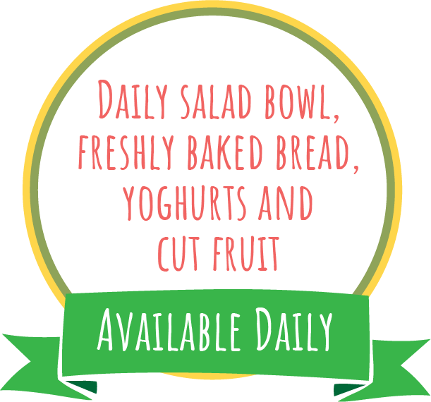
Week 1
Autumn Winter 2024-25: 2/9, 23/9, 14/10, 4/11, 25/11, 16/12, 6/1, 27/1
Margherita Pizza
Slice and Wedges
Veggie Pepper and Sweetcorn Pizza Slice with Wedges
Sweetcorn
Beans,
Cheese or
Tuna Mayo
Yoghurt & fruit
BBQ Cheesy Chicken
Halal BBQ Cheesy Chicken
Butterbean Ratatouille
Apple Slaw and Wholegrain Rice
Beans,
Cheese or
Tuna Mayo
Yoghurt & Fruit
Roast Chicken
Halal Roast Chicken, Roast Potatoes and Gravy
Quorn Sausage, Roast Potatoes and Gravy
Beans,
Cheese or
Tuna Mayo
Pudding of the Day
Peas and Carrots
Lasagne
Halal Lasagne
Vegetable Lasagne
Green Beans
Beans,
Cheese or
Tuna Mayo
Yoghurt & Fruit
Hot Pasta topped with Homemade
Tomato Sauce and Cheese
Golden Fish Fingers or Salmon Fingers and Chips
Veggie Burger and Chips
Beans,
Cheese or
Tuna Mayo
Yoghurt & Fruit
Baked Beans
T1

Slide 2
Week 2
Autumn Winter 2024-25: 9/9, 30/9, 21/10, 11/1, 2/12, 23/12, 13/1, 3/2
Cheesy Tomato Pizza Muffins
BBQ and Sweetcorn Pizza Slice
Wholegrain Pasta Salad and Green salad
Beans,
Cheese or
Tuna Mayo
Yoghurt & Fruit
Chicken and Sweetcorn Cobbler, Halal Chicken Cobbler
Winter Vegetable Crumble
Herby Diced Potato and Carrots
Beans,
Cheese or
Tuna Mayo
Yoghurt & Fruit
BBQ Chicken, Halal BBQ Chicken Roast Potatoes and Gravy
Cauliflower Cheese, Crispy Onion Topping & Roast Potatoes (You don’t have to have the onions)!
Beans,
Cheese or
Tuna Mayo
Pudding of the Day
Mixed Greens
Classic Cottage
Pie and
Halal Cottage Pie
Roasted Sweet Potato Pastry Roll and Mash
Peas
Beans,
Cheese or
Tuna Mayo
Yoghurt & Fruit
Hot Pasta topped with Homemade
Tomato Sauce & Cheese
Battered Fish and Chips
Cheese and Tomato Toasted Wrap with Chips
Beans,
Cheese or
Tuna Mayo
Yoghurt & Fruit
Baked Beans
T1

Slide 3
Week 3
Autumn Winter 2024-25: 16/9, 7/10, 28/10, 18/11, 9/12, 30/12, 20/1, 10/2
American Style Mac Cheese
Veggie Wholegrain Pasta Bolognese
Carrots
Beans,
Cheese or
Tuna Mayo
Yoghurt & Fruit
Sausage Casserole, Halal Sausage Casserole and Mash
Vegetable Pot Pie and Mash
Roast Root Veggies
Beans,
Cheese or
Tuna Mayo
Yoghurt & Fruit
Roast Chicken,Halal Roast Chicken Roast Potatoes
Stuffing & Gravy
Carrot and Stuffing Pastry Plait
Beans,
Cheese or
Tuna Mayo
Pudding of the Day
Peas and Sweetcorn
Meatballs, Halal Meatballs in Tomato Sauce, with Rice
Mild Veggie Bean Chilli Loaded Wedges with Cheese
Broccoli
Beans,
Cheese or
Tuna Mayo
Yoghurt & Fruit
Hot Pasta topped with Homemade
Tomato Sauce & Cheese
Golden Fish Fingers and Chips
Vegetable Fingers and Chips
Beans,
Cheese or
Tuna Mayo
Yoghurt & Fruit
Baked Beans
T1

